Slide 1
Waterways Commission Liberty Street and Coastline Drive Bridges November 10, 2016

Slide 2
Background – Pre Hurricane Dora - 1952

Slide 3
Background – Hurricane Dora - September 1964

Slide 4
Background – Post Hurricane Dora - 1973

Slide 5
Background – Today – Liberty Street Bridge

Slide 6
Background – Today – Coastline Drive Bridge

Slide 7
Background - Timeline
April 2012 – Oversized Crane Damages Liberty Street Bridge (Lawsuit)
February 2015 – Partial Collapse Liberty Street Bridge (Power)
May 2015 – Election (New Mayor)
June 2015 – Evaluation of Alternatives
July 1, 2015 – New Administration
July 15, 2015 – Budget submitted to Council
October 1, 2015 – Budget Passes (Includes $37M for Project)
October 28, 2015 – Part I RFP Responses Received (Shortlist)
June 15, 2016 – Part II RFP Responses Received (Winner) - Superior
July 2016 – CEI Consultant Selected - GAI
August 2016 – Contracts in process….630 Days from NTP….Permitting…

Slide 8
Site Plan - Existing

Slide 9
Site Plan - Proposed

Slide 10
Our Project

Slide 11
Our Path Forward – Proposed Milestones
Notice to Proceed – 3 October 2016
Temporary Access Road (Behind Hyatt)
Design Completion – Late 2016
Construction Completion – Early 2017
Demolition of Existing Structures – Early 2017 – Early 2018
Coastline Drive
Design Completion – Early 2017
Construction Completion – Early 2018
Liberty Street/Market Street/Riverwalk
Design Completion – Summer 2017
Construction Completion – Spring 2018

Slide 12
The Team
Residents and Neighbors:
Plaza
Hyatt
The Landing
Guests
City
JSO/JFRD/Parks/DIA/DPW
FDOT Partners – CH2MHill, STV
Design-Build Team – Superior/HDR
City’s CEI Consultant – GAI
Outreach – Downtown Vision, Inc.

Slide 13
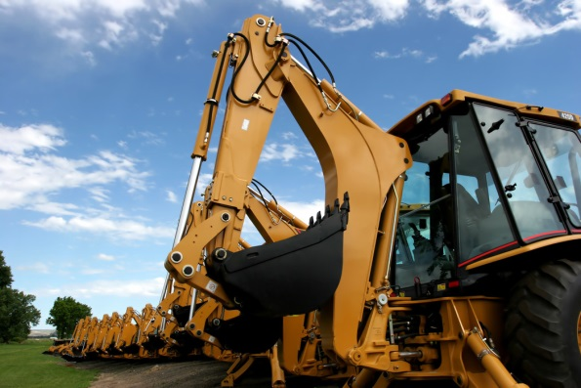
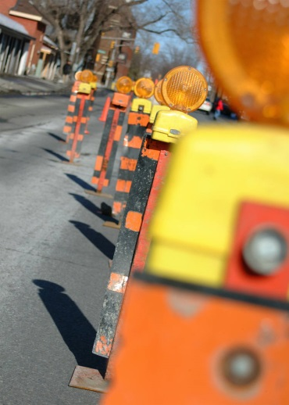
Questions?

